Slide 1
Design and Analysis of Algorithms
Jing Tang | DSAA 2043 Fall 2024

Slide 2
Hashing

Slide 3
Outline
Hash tables are another sort of data structure that allows fast INSERT/DELETE/SEARCH.
like self-balancing binary trees
The difference is we can get better performance in expectation by using randomness.
Hash families are the magic behind hash tables.
Universal hash families are even more magical.

Slide 4
Goal
We want to store nodes with keys in a data structure that supports fast INSERT/DELETE/SEARCH.
INSERT
DELETE
SEARCH
node with key “2”
5
2
5
4
4
52
52
data structure
HERE IT IS

Slide 5
Last time
Self balancing trees:
O(log(n)) deterministic INSERT/DELETE/SEARCH
#prettysweet
Today:
Hash tables:
O(1) expected time INSERT/DELETE/SEARCH
Worse worst-case performance, but often great in practice.
#evensweeterinpractice
eg, Python’s dict, Java’s HashSet/HashMap, C++’s unordered_map
Hash tables are used for databases, caching, object representation, …

Slide 6
One way to get O(1) time
Say all keys are in the set {1,2,3,4,5,6,7,8,9}.
INSERT:
DELETE:
SEARCH:
This is called “direct addressing”
9
6
3
5
6
Are we delegating to hardware/memory? What are the assumptions behind our model of computation?
3
2
2 isn’t in the data structure.
3 is here.
3
5
6
9
1
2
3
4
5
6
7
8
9

Slide 7
That should look familiar
The universe is really big!
If the keys may come from a “universe” U = {1,2, …., 10000000000}, it takes a lot of space.

Slide 8
Solution?
Put things in buckets based on one digit
INSERT:
21
345
13
101
50
234
1
1
101
234
345
50
13
21
0
1
2
3
4
5
6
7
8
9
It’s in this bucket somewhere…
go through until we find it.
21
Now SEARCH

Slide 9
Problem…
2
232
INSERT:
52
22
342
12
102
52
232
2
102
12
342
22
0
1
2
3
4
5
6
7
8
9
22
….this hasn’t made our lives easier…
Now SEARCH

Slide 10
Hash tables
That was an example of a hash table.
not a very good one, though.
We will be more clever (and less deterministic) about our bucketing.
This will result in fast (expected time) INSERT/DELETE/SEARCH.

Slide 11
But first! Terminology
U is a universe of size M.
M is really big.
But only a few (at most n) elements of U are ever going to show up.
M is waaaayyyyyyy bigger than n.
But we don’t know which ones will show up in advance.
All of the keys in the universe live in this blob.
Only n keys will ever show up.
22
Example: U is the set of all strings of at most 280 ascii characters. (128²⁸⁰ of them).
The only ones which I care about are those which appear as trending hashtags on twitter. #hashinghashtags
There are way fewer than 128²⁸⁰ of these.
13
Universe U

Slide 12
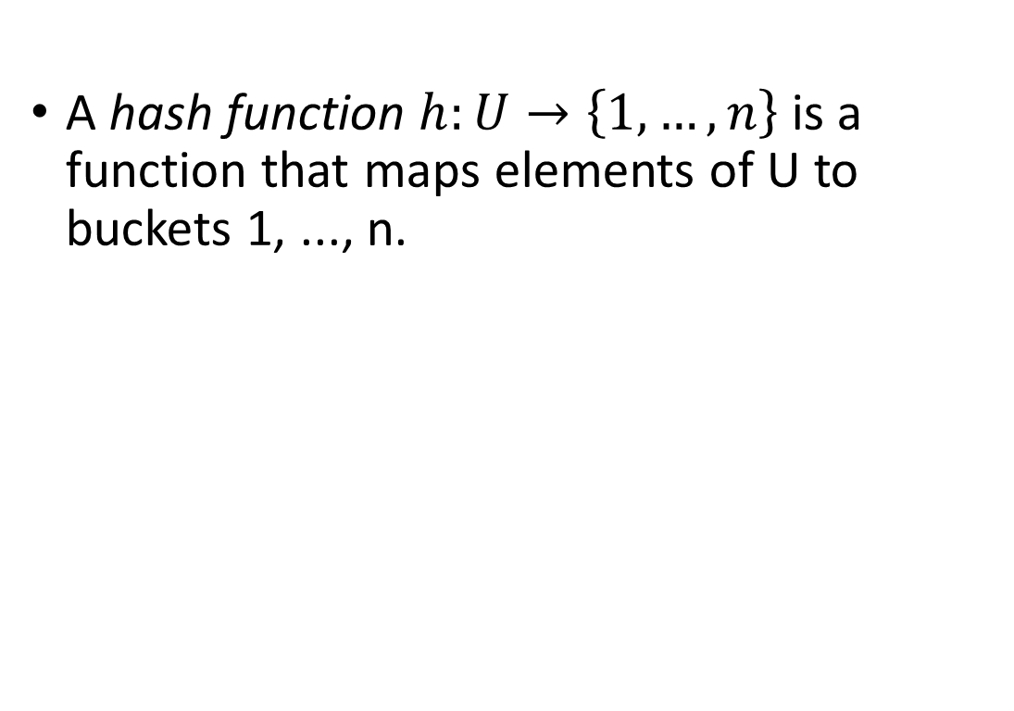
Hash Functions
A hash function $h:U→\left\{1, …, n\right\}$ is a function that maps elements of U to buckets 1, ..., n.
For this lecture, we are assuming that the number of things that show up is the same as the number of buckets, both are n.
This doesn’t have to be the case, although we do want:
#buckets = O( #things which show up )
All of the keys in the universe live in this blob.
Example:
h(x) = least significant digit of x.
22
1
n buckets
13
2
h(22) = 2
3
h(13) = 3
Universe U

Slide 13
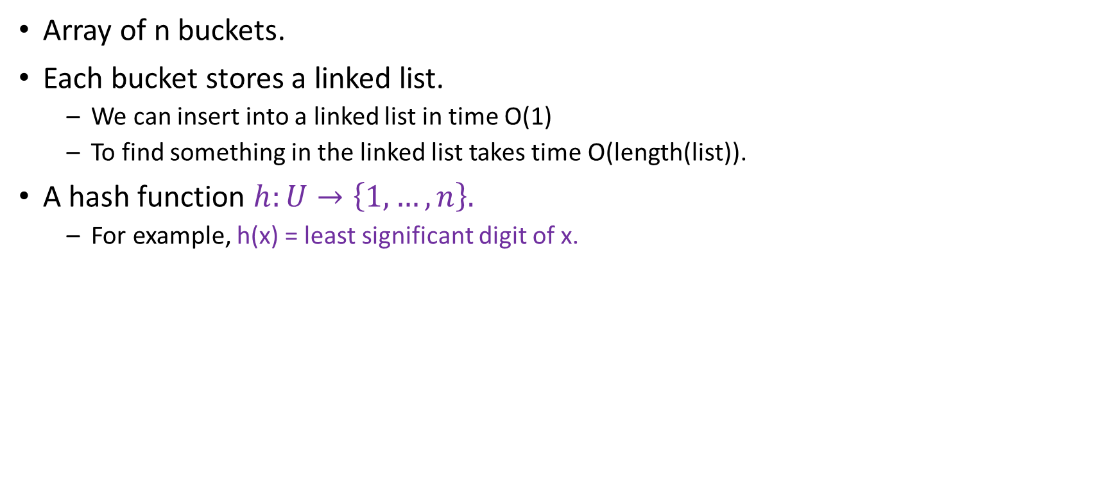
Hash Tables (with chaining)
For demonstration purposes only!
This is a terrible hash function! Don’t use this!
Array of n buckets.
Each bucket stores a linked list.
We can insert into a linked list in time O(1)
To find something in the linked list takes time O(length(list)).
A hash function $h:U→\left\{1, …, n\right\}.$
For example, h(x) = least significant digit of x.
INSERT:
1
2
22
13
22
43
9
3
13
43
SEARCH 43:
Scan through all the elements in bucket h(43) = 3.
…
9
9
DELETE 43:
n buckets (say n=9)
Search for 43 and remove it.

Slide 14
Aside: Hash tables with open addressing
The previous slide is about hash tables with chaining.
There’s also something called “open addressing”
You don’t need to know about it for this class.
1
1
2
2
3
13
43
13
3
bounce!
…
43
This is a “chain”
…
9
9
n=9 buckets
n=9 buckets
\end{Aside}

Slide 15

Hash Tables (with chaining)
For demonstration purposes only!
This is a terrible hash function! Don’t use this!
Array of n buckets.
Each bucket stores a linked list.
We can insert into a linked list in time O(1)
To find something in the linked list takes time O(length(list)).
A hash function $h:U→\left\{1, …, n\right\}.$
For example, h(x) = least significant digit of x.
INSERT:
1
2
22
13
22
43
9
3
13
43
SEARCH 43:
Scan through all the elements in bucket h(43) = 3.
…
9
9
DELETE 43:
n buckets (say n=9)
Search for 43 and remove it.

Slide 16
What we want from a hash table
We want there to be not many buckets (say, n).
This means we don’t use too much space
We want the items to be pretty spread-out in the buckets.
This means it will be fast to SEARCH/INSERT/DELETE
93
1
21
vs.
1
3
2
22
2
23
3
13
43
3
13
43
…
…
9
9
9
n=9 buckets
n=9 buckets

Slide 17
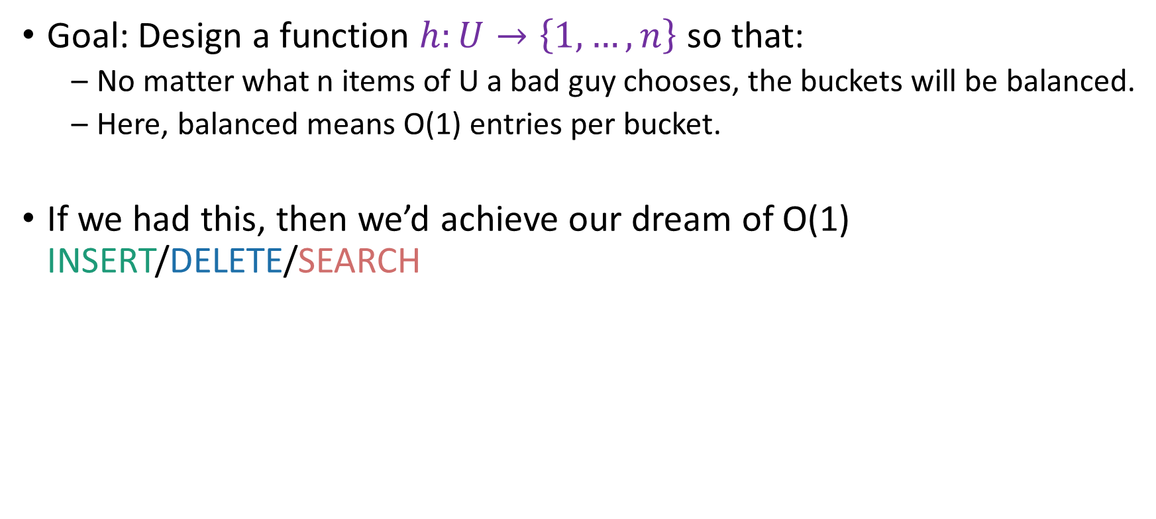
Worst-case analysis
Goal: Design a function $h:U→\left\{1, …, n\right\}$ so that:
No matter what n items of U a bad guy chooses, the buckets will be balanced.
Here, balanced means O(1) entries per bucket.
If we had this, then we’d achieve our dream of O(1) INSERT/DELETE/SEARCH
Can you come up with such a function?
Think-Share Terrapins

Slide 18
This is impossible!
93
3
23
13
43
No deterministic hash function can defeat worst-case input!

Slide 19
We really can’t beat the bad guy here.
The universe U has M items
They get hashed into n buckets
At least one bucket has at least M/n items hashed to it.
M is waayyyy bigger than n, so M/n is bigger than n.
Bad guy chooses n of the items that landed in this very full bucket.
.
h(x)
n buckets
These are all the things that hash to the first bucket.
Universe U

Slide 20
Solution: Randomness

Slide 21
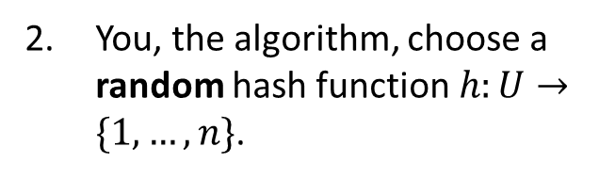
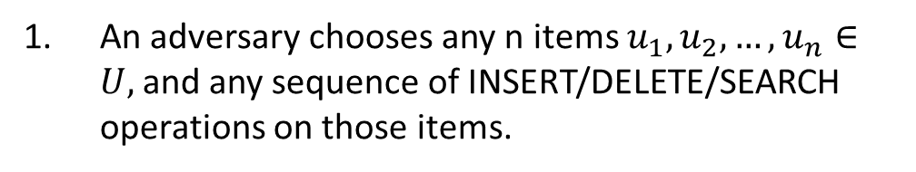
The game
What does random mean here? Uniformly random?
You, the algorithm, choose a random hash function $h:U→\{1,…,n\}$.
Plucky the pedantic penguin
An adversary chooses any n items $u_{1},u_{2},…, u_{n}∈U,$and any sequence of INSERT/DELETE/SEARCH operations on those items.
HASH IT OUT
13
43
92
7
#hashpuns
22
1
43
2
INSERT 13, INSERT 22, INSERT 43, INSERT 92, INSERT 7, SEARCH 43, DELETE 92, SEARCH 7, INSERT 92
22
3
13
u_{j}
…
u_{k}
n
u_{i}
92
7

Slide 22
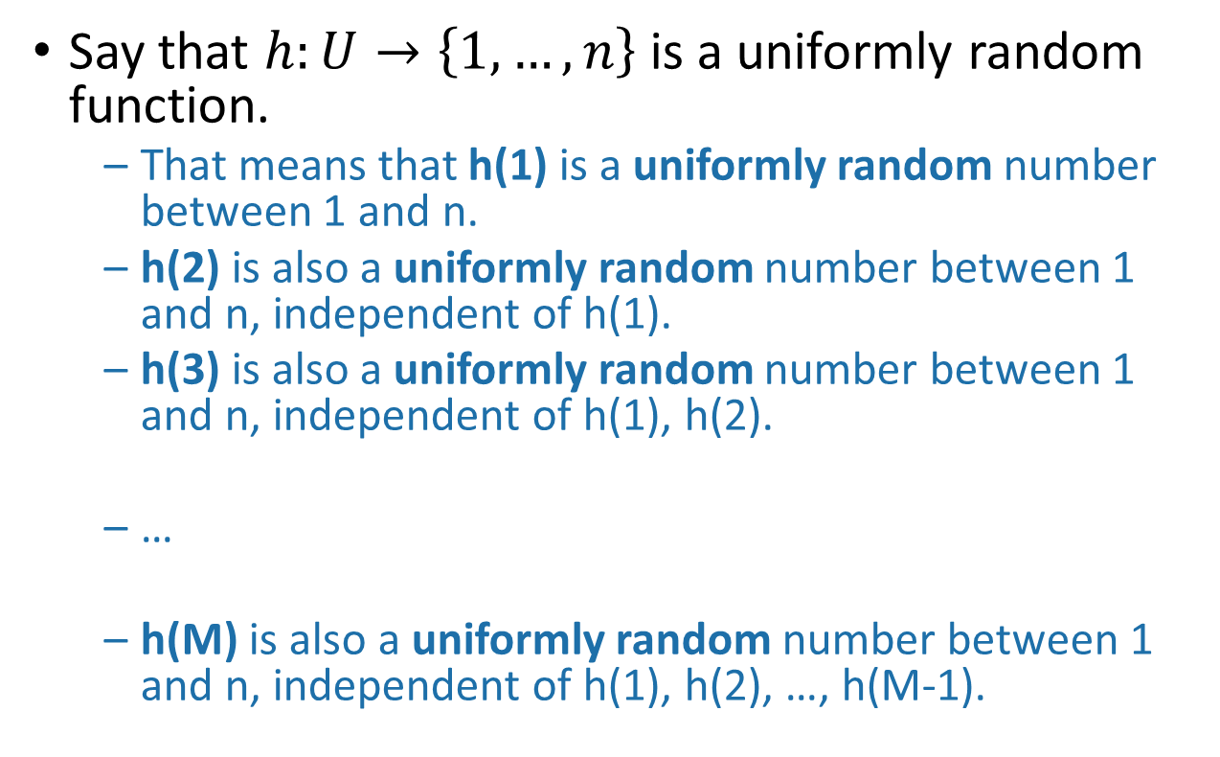
Example of a random hash function
Say that $h:U→\left\{1,…,n\right\}$ is a uniformly random function.
That means that h(1) is a uniformly random number between 1 and n.
h(2) is also a uniformly random number between 1 and n, independent of h(1).
h(3) is also a uniformly random number between 1 and n, independent of h(1), h(2).
…
h(M) is also a uniformly random number between 1 and n, independent of h(1), h(2), …, h(M-1).
Universe U
h
n buckets

Slide 23
Randomness helps
Intuitively: The bad guy can’t foil a hash function that he doesn’t yet know.
Lucky the Lackadaisical Lemur
Why not? What if there’s some strategy that foils a random function with high probability?
Plucky the Pedantic Penguin
We’ll need to do some analysis…

Slide 24
What do we want?
It’s bad if lots of items land in u_{i}’s bucket.
So we want not that.
1
43
2
22
3
14
7
u_{i}
32
5
15
…
n
92
8

Slide 25

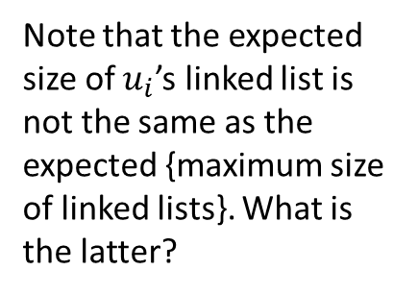
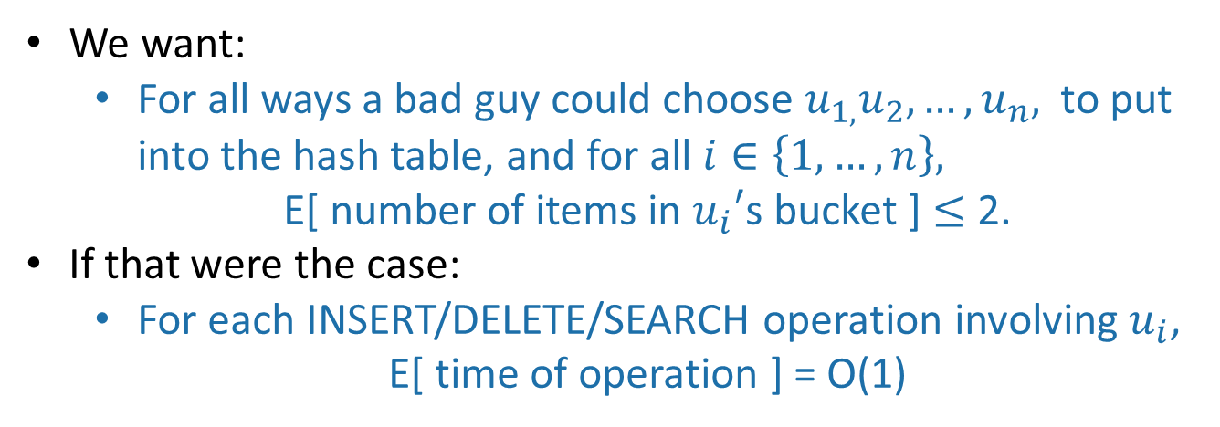
More precisely
We want:
For all ways a bad guy could choose $u_{1,}u_{2},…, u_{n},$ to put into the hash table, and for all $i∈\left\{1, …, n\right\},$
E[ number of items in $u_{i}′$s bucket ] $≤$ 2.
If that were the case:
For each INSERT/DELETE/SEARCH operation involving $u_{i}$,
E[ time of operation ] = O(1)
We could replace “2” here with any constant; it would still be good. But “2” will be convenient.
1
43
This is what we wanted at the beginning of lecture!
22
Note that the expected size of $u_{i}$’s linked list is not the same as the expected {maximum size of linked lists}. What is the latter?
2
3
14
$$u_{i}$$
…
n
92
8

Slide 26
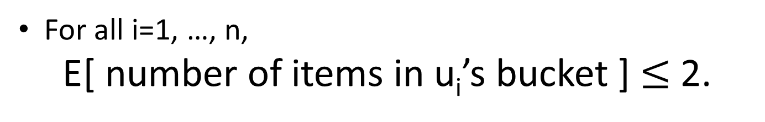
So we want:
For all i=1, …, n,
E[ number of items in u_{i}’s bucket ] $≤$ 2.

Slide 27
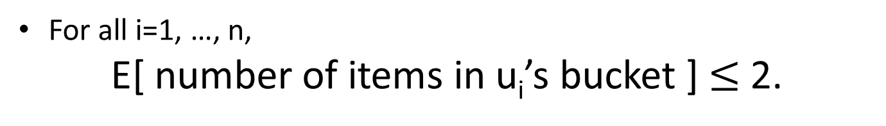

Aside
For all i=1, …, n,
E[ number of items in u_{i}’s bucket ] $≤$ 2.
vs
For all i=1,…,n:
E[ number of items in bucket i ] $≤$ 2
Suppose that:
1
43
14
22
92
8
this happens with probability 1/n
2
3
1
2
43
14
22
92
8
…
3
and this happens with probability 1/n
n
etc.
…
Then E[ number of items in bucket i ] = 1 for all i.
But E[ number of items in 43’s bucket ] = n
n

Slide 28
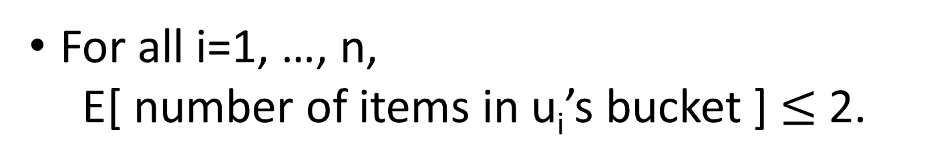
So we want:
For all i=1, …, n,
E[ number of items in u_{i}’s bucket ] $≤$ 2.

Slide 29

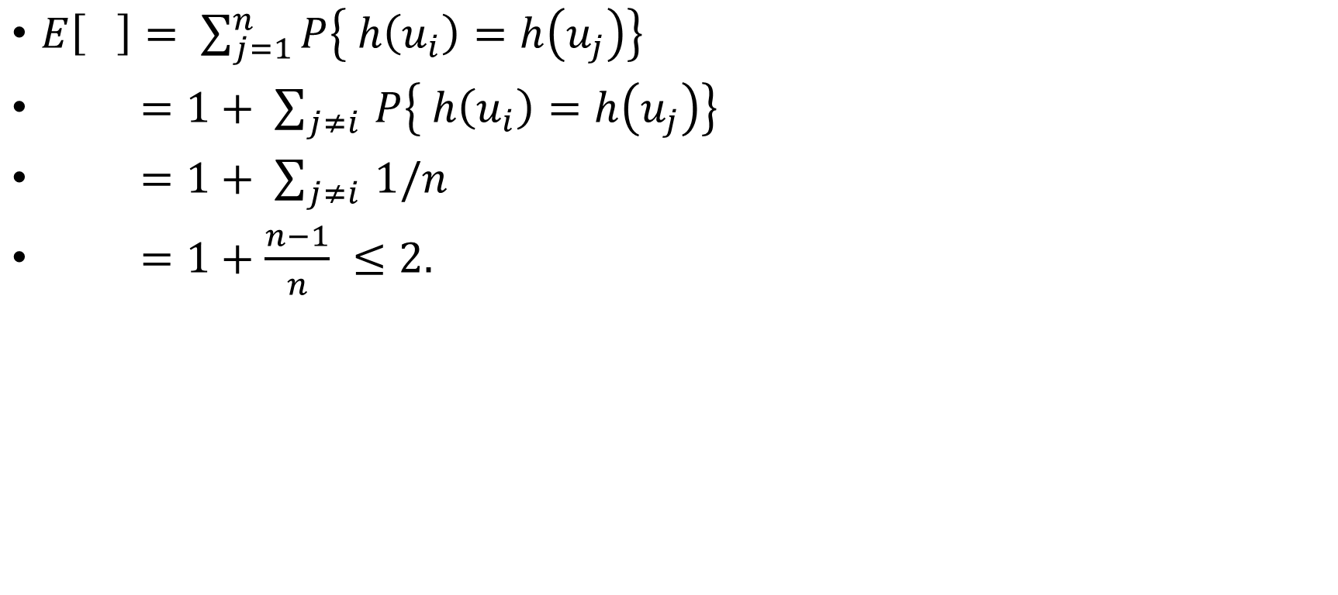



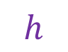

Expected number of items in $u_{i}$’s bucket?
h is uniformly random
$E\left[ \right]= \sum_{j=1}^{n}{P\left\{ h\left(u_{i}\right)=h\left(u_{j}\right)\right\}}$
$=1+ \sum_{j≠i }{P\left\{ h\left(u_{i}\right)=h\left(u_{j}\right)\right\}}$
$=1+ \sum_{j≠i }{1/n}$
$=1+\frac{n−1}{n} ≤2.$
That’s what we wanted!
Universe U
$$h$$
$$u_{k}$$
$$u_{i}$$
n buckets
$$u_{j}$$
$$u_{i}$$
$$u_{j}$$
COLLISION!

Slide 30
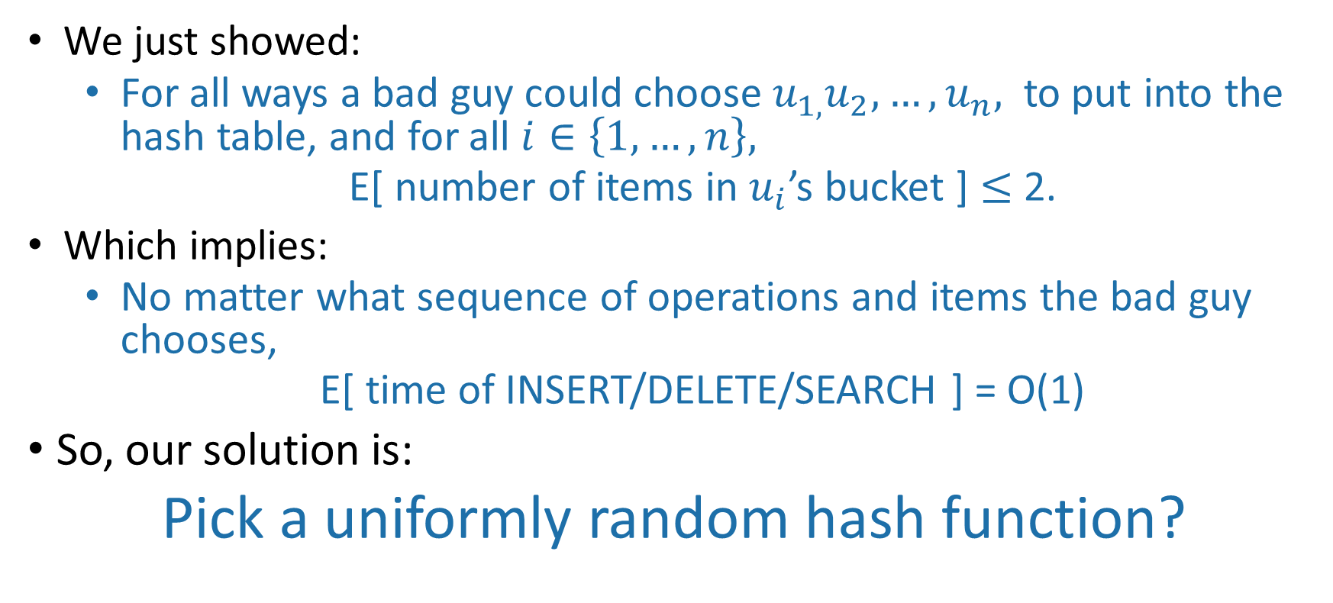
A uniformly random hash function leads to balanced buckets
We just showed:
For all ways a bad guy could choose $u_{1,}u_{2},…, u_{n},$ to put into the hash table, and for all $i∈\left\{1, …, n\right\},$
E[ number of items in $u_{i}$’s bucket ] $≤$ 2.
Which implies:
No matter what sequence of operations and items the bad guy chooses,
E[ time of INSERT/DELETE/SEARCH ] = O(1)
So, our solution is:
Pick a uniformly random hash function?

Slide 31
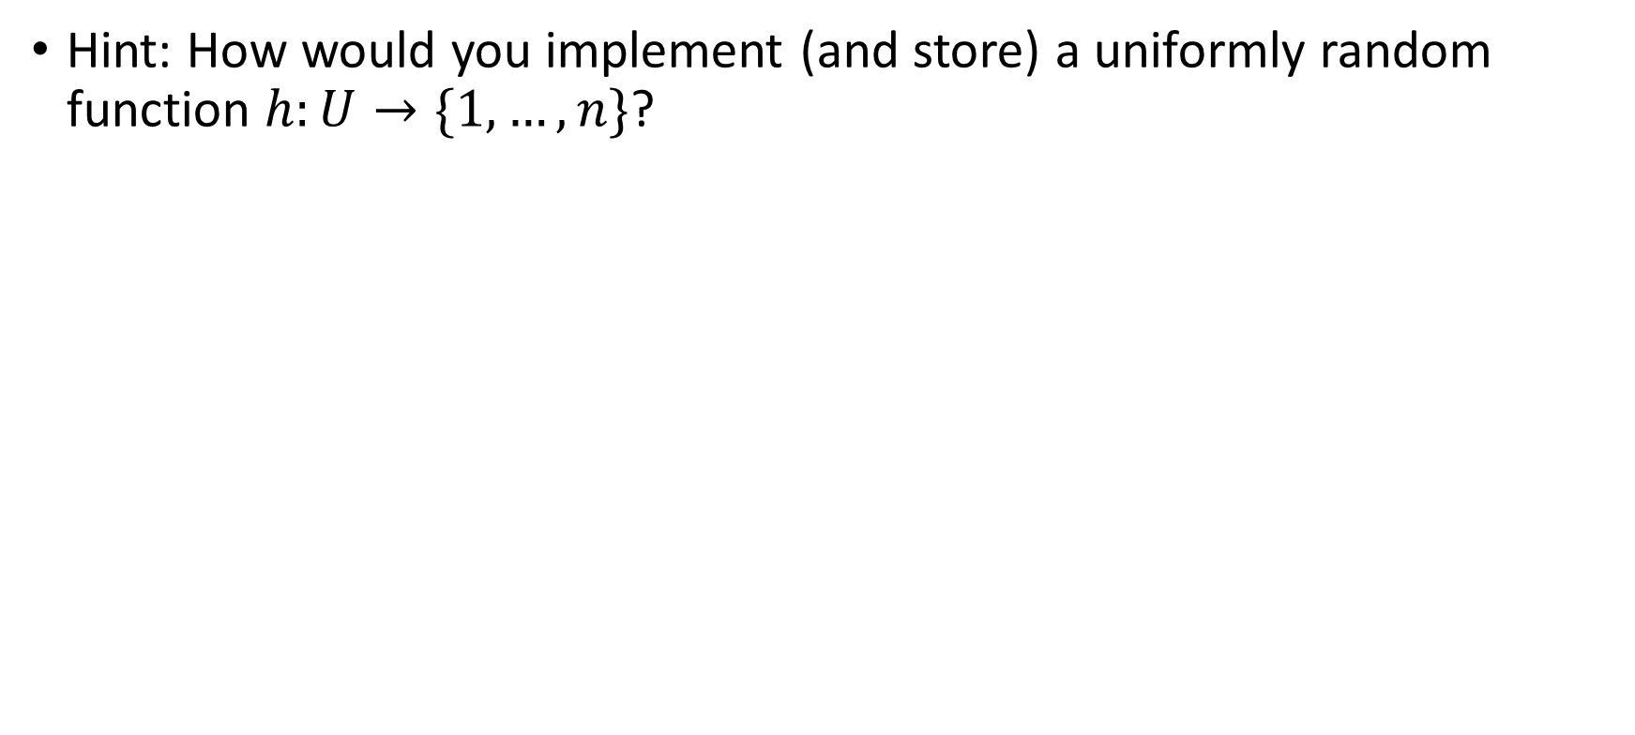
What’s wrong with this plan?
Hint: How would you implement (and store) a uniformly random function $h:U→\{1,…,n\}$?
If h is a uniformly random function:
That means that h(1) is a uniformly random number between 1 and n.
h(2) is also a uniformly random number between 1 and n, independent of h(1).
h(3) is also a uniformly random number between 1 and n, independent of h(1), h(2).
…
h(n) is also a uniformly random number between 1 and n, independent of h(1), h(2), …, h(n-1).
Think-Share Terrapins

Slide 32
A uniformly random hash function is not a good idea
In order to store/evaluate a uniformly random hash function, we’d use a lookup table:
x | h(x)
AAAAAA | 1
AAAAAB | 5
AAAAAC | 3
AAAAAD | 3
…
ZZZZZY | 7
ZZZZZZ | 3
Each value of h(x) takes log(n) bits to store.
Storing M such values requires Mlog(n) bits.
In contrast, direct addressing (initializing a bucket for every item in the universe) requires only M bits.
All of the M things in the universe

Slide 33
Another way to say this
There are lots of hash functions.
There are n^{M} of them.
Writing down a random one of them takes log(n^{M}) bits, which is Mlog(n).
All of the hash functions
h:U →{1,…,n}

Slide 34
Another thought…
THIS SLIDE SKIPPED IN CLASS
Just remember h on the relevant values
h(7) = 8
h(43) = 2
h(92) = 3
13
43
7
22
92
h(22) = 3
h(13) = 6
h(13) = 6
We need some way of storing keys and values with O(1) INSERT/DELETE/SEARCH…
h(22) = 3
Algorithm later
Algorithm now

Slide 35
Could we store a uniformly random h without using a lookup table?
THIS SLIDE SKIPPED IN CLASS
Maybe there’s a different way to store h that uses less space?

Slide 36
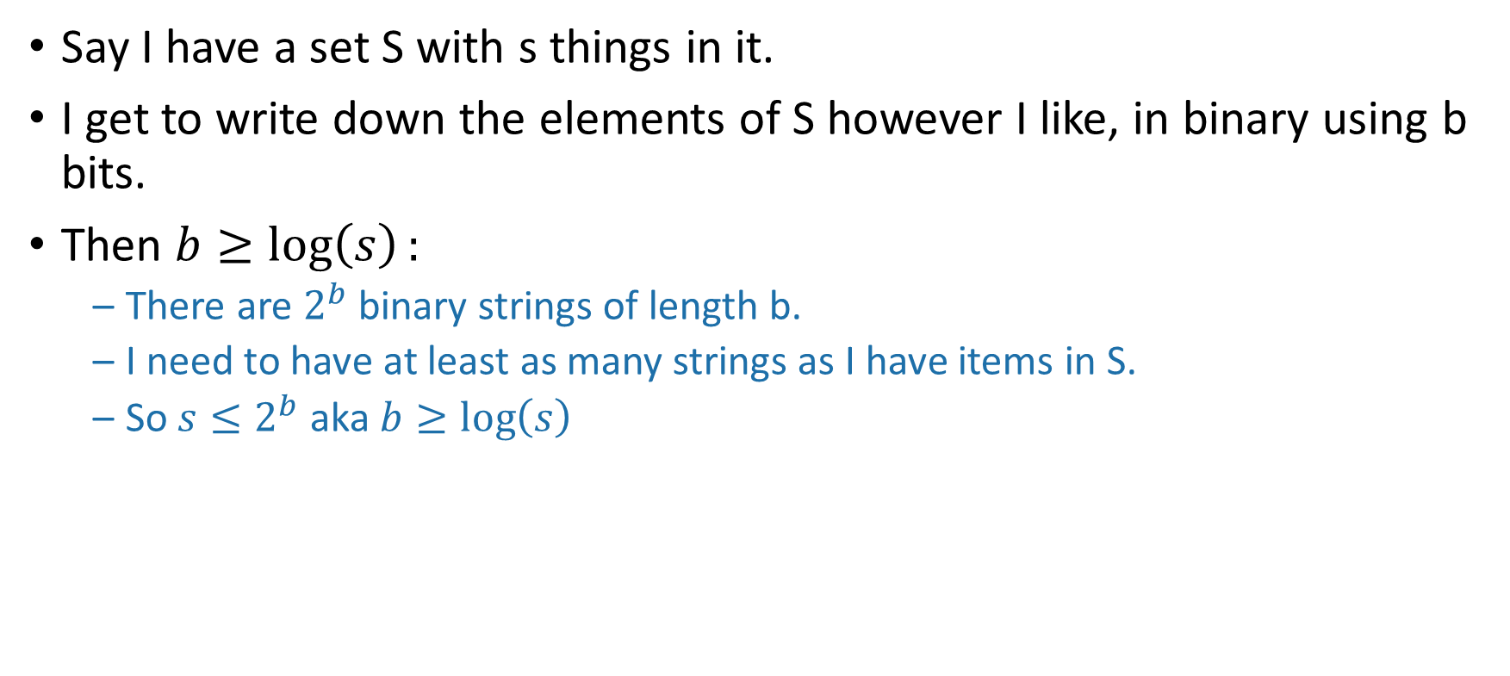
Aside: description length
THIS SLIDE SKIPPED IN CLASS
Say I have a set S with s things in it.
I get to write down the elements of S however I like, in binary using b bits.
Then $b≥\log\left(s\right):$
There are $2^{b}$ binary strings of length b.
I need to have at least as many strings as I have items in S.
So $s≤2^{b}$ aka $b≥\log\left(s\right)$
S
I’ll call this one “Fido”
This one is named “Hercules”
Or, 011011
Or, 101111

Slide 37
Could we store a uniformly random h without using a lookup table?
THIS SLIDE SKIPPED IN CLASS
Maybe there’s a different way to store h that uses less space?

Slide 38
Need Mlog(n) bits to store a random hash function
Say that this elephant-shaped blob represents the set of all hash functions.
It has size n^{M}. (Really big!)
THIS SLIDE SKIPPED IN CLASS
To write down a random hash function, we need log(n^{M}) = Mlog(n) bits.
All of the hash functions
h:U →{1,…,n}
Technically we should argue that we need at least Mlog(n) bits on average when we draw a random hash function… why can’t one item have a really long name and others have shorter names?

Slide 39
Solution
Pick from a smaller set of functions.
A cleverly chosen subset of functions. We call such a subset a hash family.
All of the hash functions h:U →{1,…,n}
H
We need only log|H| bits to store an element of H.

Slide 40
Outline
Hash tables are another sort of data structure that allows fast INSERT/DELETE/SEARCH.
like self-balancing binary trees
The difference is we can get better performance in expectation by using randomness.
Hash families are the magic behind hash tables.
Universal hash families are even more magic.

Slide 41
Hash families
A hash family is a collection of hash functions.
All of the hash functions h:U →{1,…,n}
“All of the hash functions” is an example of a hash family.

Slide 42
Example: a smaller hash family
This is still a terrible idea! Don’t use this example!
For pedagogical purposes only!
H = { function which returns the least sig. digit,
function which returns the most sig. digit }
Pick h in H at random.
Store just one bit to remember which we picked.
All of the hash functions h:U →{1,…,n}
H

Slide 43
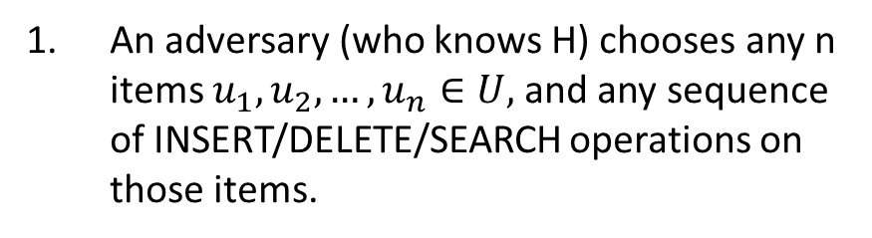
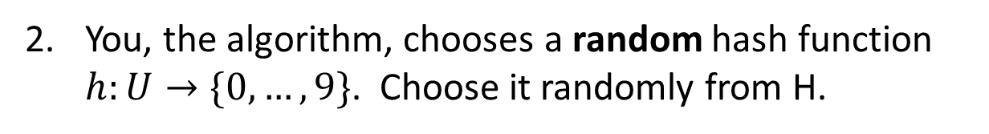
The game
h₀ = Most_significant_digit
h₁ = Least_significant_digit
H = {h₀, h₁}
You, the algorithm, chooses a random hash function $h:U→\{0,…, 9\}$. Choose it randomly from H.
An adversary (who knows H) chooses any n items $u_{1},u_{2},…, u_{n}∈U,$and any sequence of INSERT/DELETE/SEARCH operations on those items.
I picked h₁
HASH IT OUT
19
22
42
92
0
#hashpuns
0
0
INSERT 19, INSERT 22, INSERT 42, INSERT 92, INSERT 0, SEARCH 42, DELETE 92, SEARCH 0, INSERT 92
1
22
42
92
2
u_{j}
u_{k}
…
u_{i}
9
19

Slide 44
This is not a very good hash family
H = { function which returns least sig. digit,
function which returns most sig. digit }
On the previous slide, the adversary could have been a lot more adversarial…

Slide 45
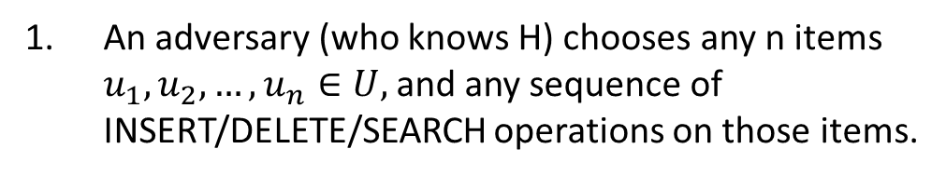
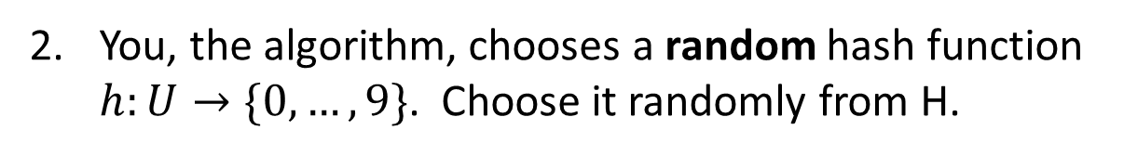
The game
h₀ = Most_significant_digit
h₁ = Least_significant_digit
H = {h₀, h₁}
You, the algorithm, chooses a random hash function $h:U→\{0,…, 9\}$. Choose it randomly from H.
An adversary (who knows H) chooses any n items $u_{1},u_{2},…, u_{n}∈U,$and any sequence of INSERT/DELETE/SEARCH operations on those items.
I picked h₁
HASH IT OUT
101
11
121
141
#hashpuns
131
0
1
11
101
2
141
u_{k}
u_{j}
u_{i}
…
121
9
131

Slide 46
Outline
Hash tables are another sort of data structure that allows fast INSERT/DELETE/SEARCH.
like self-balancing binary trees
The difference is we can get better performance in expectation by using randomness.
Hash families are the magic behind hash tables.
Universal hash families are even more magic.

Slide 47
How to pick the hash family?
Definitely not like in that example.
Let’s go back to that computation from earlier….
H

Slide 48
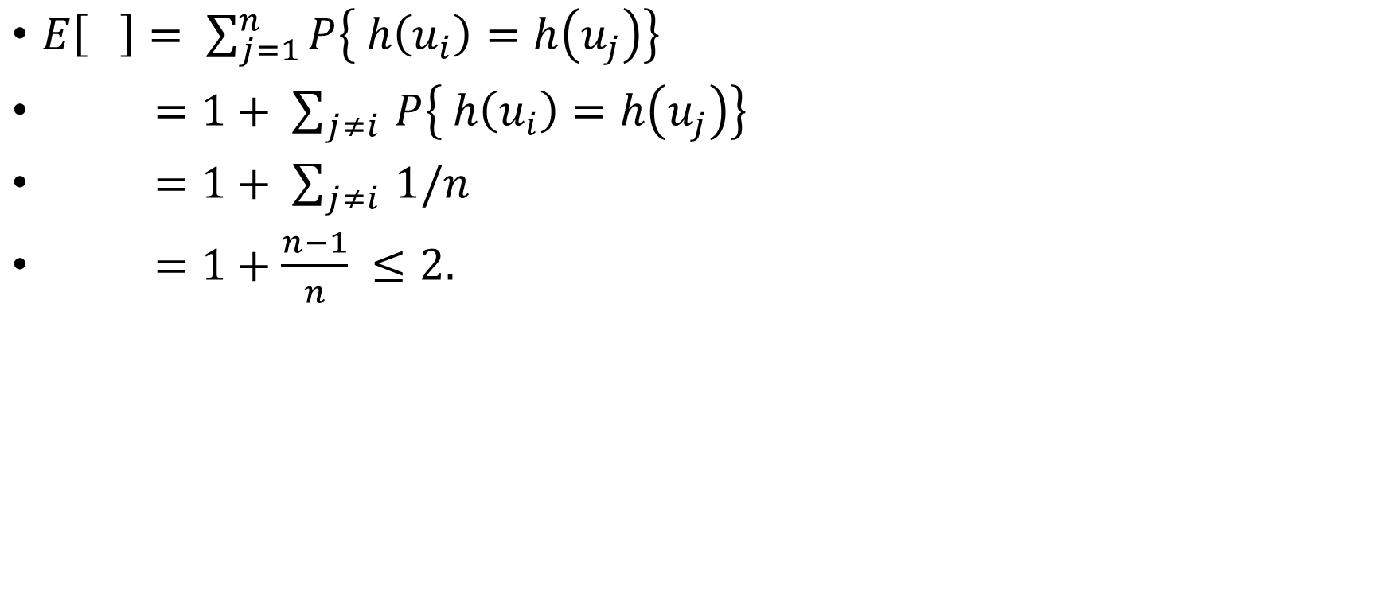
Expected number of items in u_{i}’s bucket?
$E\left[ \right]= \sum_{j=1}^{n}{P\left\{ h\left(u_{i}\right)=h\left(u_{j}\right)\right\}}$
$=1+ \sum_{j≠i }{P\left\{ h\left(u_{i}\right)=h\left(u_{j}\right)\right\}}$
$=1+ \sum_{j≠i }{1/n}$
$=1+\frac{n−1}{n} ≤2.$
All that we needed was that this is 1/n
Universe U
h
u_{k}
u_{i}
n buckets
u_{j}
u_{i}
u_{j}
COLLISION!

Slide 49
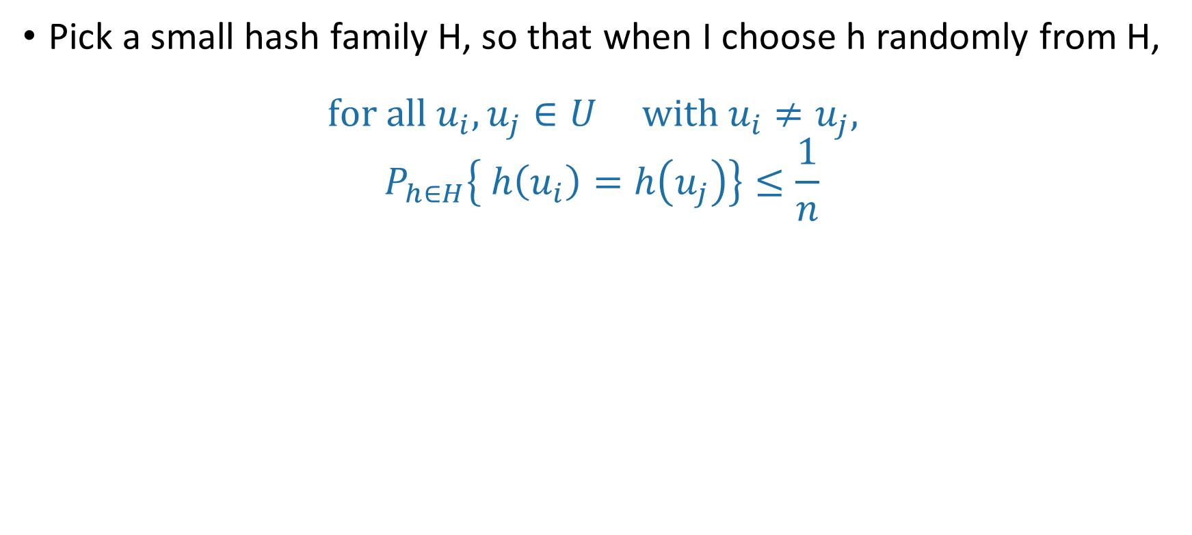
Strategy
Pick a small hash family H, so that when I choose h randomly from H,
$$for all u_{i}, u_{j}∈U with u_{i}≠u_{j},$$
$$P_{h∈H}\left\{ h\left(u_{i}\right)=h\left(u_{j}\right)\right\}≤\frac{1}{n}$$
In English: fix any two elements of U. The probability that they collide under a random h in H is small.
A hash family H that satisfies this is called a universal hash family.
h
H

Slide 50
So the whole scheme will be
Choose h randomly from a universal hash family H
We can store h using log|H| bits.
u₁
u_{k}
Probably these buckets will be pretty balanced.
u_{i}
u_{j}
h
n buckets
u_{i}
Universe U

Slide 51
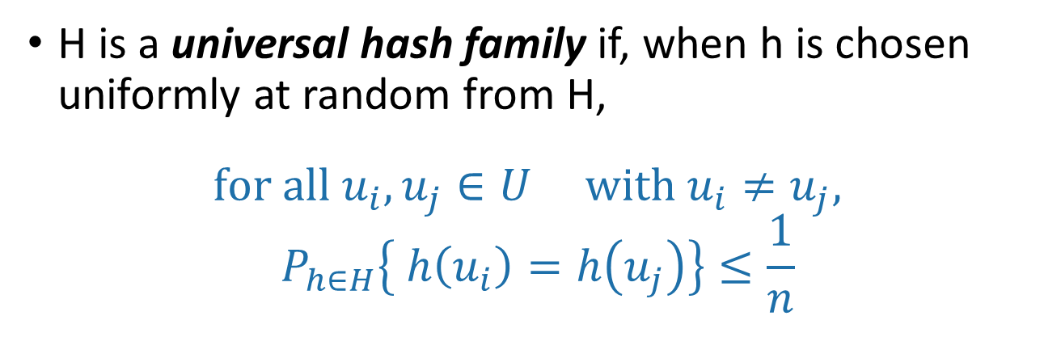
Universal hash family
H is a universal hash family if, when h is chosen uniformly at random from H,
$$for all u_{i}, u_{j}∈U with u_{i}≠u_{j},$$
$$P_{h∈H}\left\{ h\left(u_{i}\right)=h\left(u_{j}\right)\right\}≤\frac{1}{n}$$

Slide 52
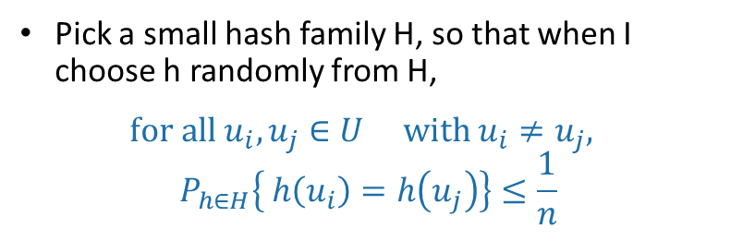
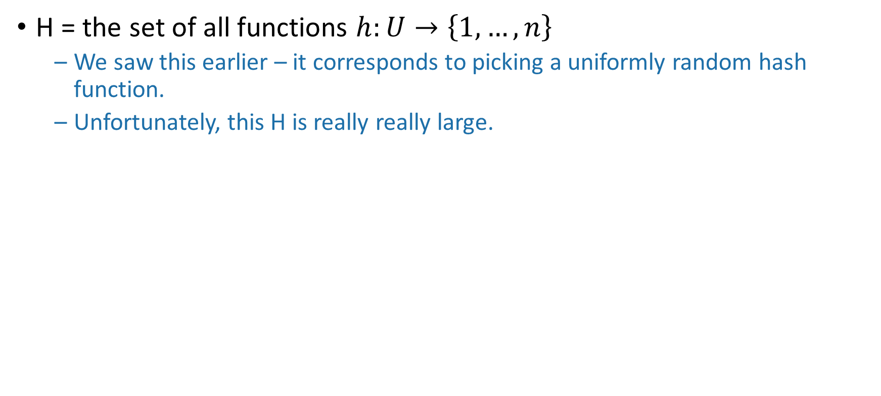
Example
Pick a small hash family H, so that when I choose h randomly from H,
$$for all u_{i}, u_{j}∈U with u_{i}≠u_{j},$$
$$P_{h∈H}\left\{ h\left(u_{i}\right)=h\left(u_{j}\right)\right\}≤\frac{1}{n}$$
H = the set of all functions $h:U→\left\{1,…,n\right\}$
We saw this earlier – it corresponds to picking a uniformly random hash function.
Unfortunately, this H is really really large.

Slide 53
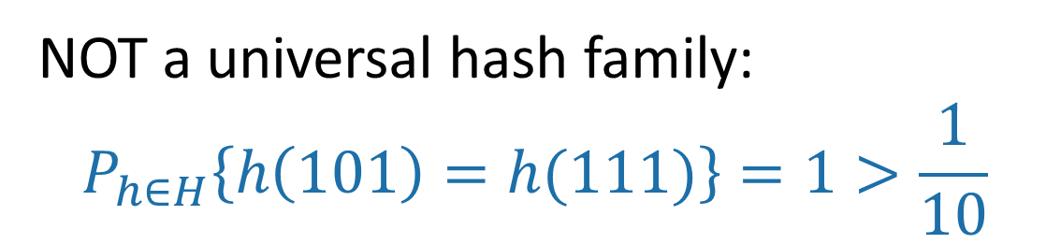
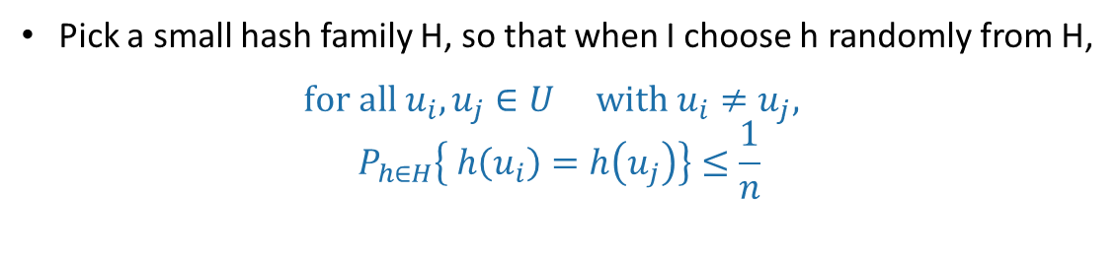
Non-example
Pick a small hash family H, so that when I choose h randomly from H,
$$for all u_{i}, u_{j}∈U with u_{i}≠u_{j},$$
$$P_{h∈H}\left\{ h\left(u_{i}\right)=h\left(u_{j}\right)\right\}≤\frac{1}{n}$$
h₀ = Most_significant_digit
h₁ = Least_significant_digit
H = {h₀, h₁}
NOT a universal hash family:
$$P_{h∈H}\left\{h\left(101\right)=h(111)\right\}=1>\frac{1}{10}$$

Slide 54
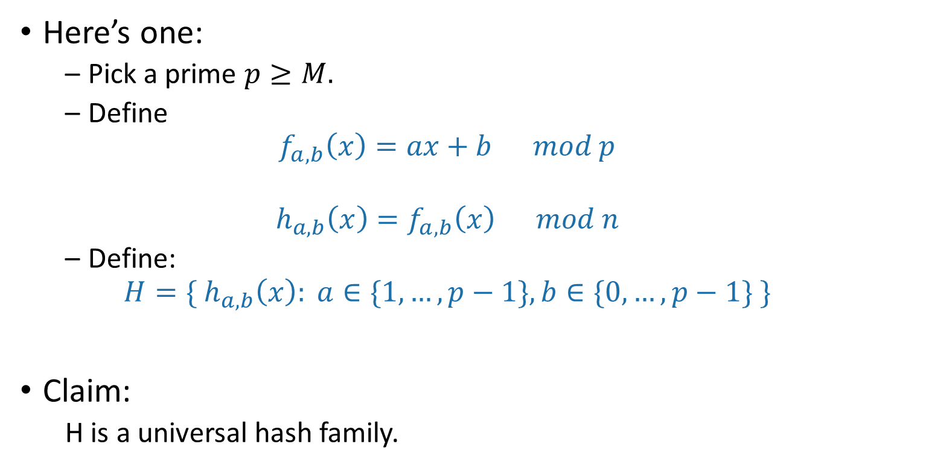
A small universal hash family??
How do you pick the prime number p that’s not too larger than M?
Here’s one:
Pick a prime $p≥M.$
Define
$$f_{a,b}\left(x\right)=ax+b mod p$$
$$h_{a,b}\left(x\right)=f_{a,b}\left(x\right) mod n$$
Define:
$$H=\{ h_{a,b}\left(x\right): a∈\{1,…, p−1\}, b∈\{0, …, p−1\} \}$$
Claim:
H is a universal hash family.
??

Slide 55
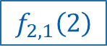
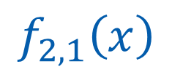
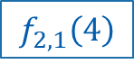
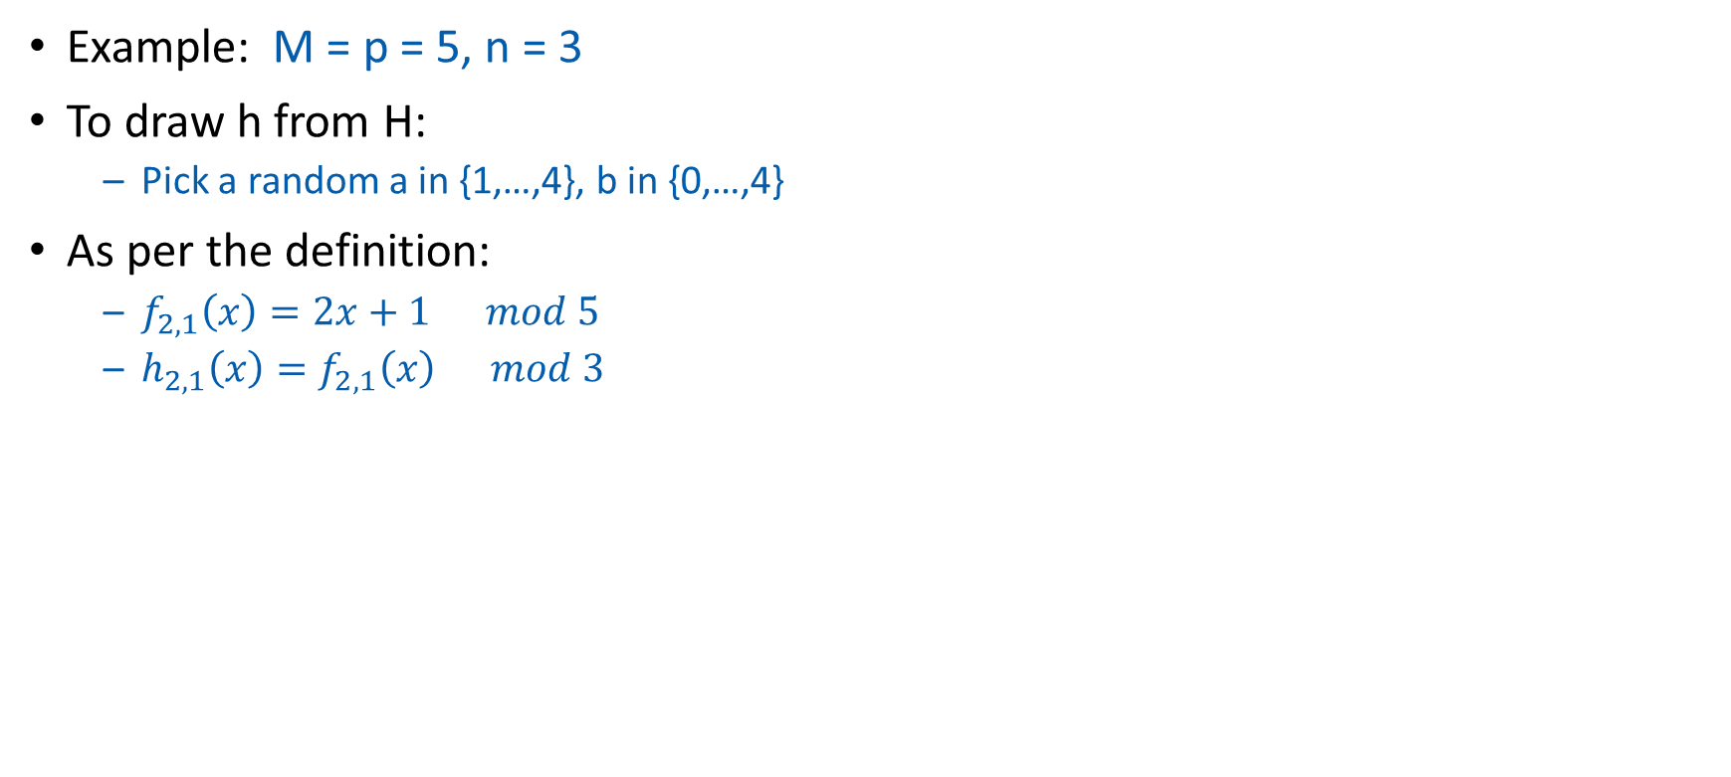
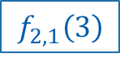
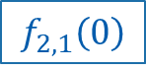
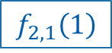
Say what?
Example: M = p = 5, n = 3
To draw h from H:
Pick a random a in {1,…,4}, b in {0,…,4}
As per the definition:
$f_{2,1}\left(x\right)=2x+1 mod 5$
$h_{2,1}\left(x\right)=f_{2,1}\left(x\right) mod 3$
1,2,3,4,5
a = 2, b = 1
$$f_{2,1}\left(3\right)$$
1
$$f_{2,1}\left(1\right)$$
2
3
$$f_{2,1}\left(x\right)$$
3
2
1
mod 3
2
4
1
$$f_{2,1}\left(0\right)$$
0
4
0
$$f_{2,1}\left(4\right)$$
3
U =
This step just scrambles stuff up. No collisions here!
$$f_{2,1}\left(2\right)$$
This step is the one where two different elements might collide.

Slide 56
h takes O(log M) bits to store
1,2,3,4,5
Just need to store two numbers:
a is in {1,…,p-1}
b is in {0,…,p-1}
So about 2log(p) bits
By our choice of p (close to M), that’s O(log(M)) bits.
Also, given a and b, h is fast to evaluate!
It takes time O(1) to compute h(x).
Compare: direct addressing was M bits!
Twitter example: 2log(M) =2*280 log(128) = 3920 vs M = 128²⁸⁰
a = 2, b = 1

Slide 57
Why does this work?
This is actually a little complicated.
Find the proof if you are curious.
You are NOT RESPONSIBLE for the proof in this class.
But you should know that a universal hash family of size O(M²) exists.
Try to prove that this is a universal hash family!

Slide 58

But let’s check that it does work
Check out the Python notebook
M=200, n=10
Number of pairs of (x,y).
(Out of $\left({200 \atop 2}\right)= 19900$pairs)
Empirical probability of collision out of 100 trials

Slide 59
So the whole scheme will be
Choose a and b at random and form the function h_{a,b}
We can store h in space O(log(M)) since we just need to store a and b.
u₁
u_{k}
Probably these buckets will be pretty balanced.
u_{i}
u_{j}
h_{a,b}
n buckets
u_{i}
Universe U

Slide 60
Outline
Hash tables are another sort of data structure that allows fast INSERT/DELETE/SEARCH.
like self-balancing binary trees
The difference is we can get better performance in expectation by using randomness.
Hash families are the magic behind hash tables.
Universal hash families are even more magic.
Recap

Slide 61
Want O(1) INSERT/DELETE/SEARCH
We are interested in putting nodes with keys into a data structure that supports fast INSERT/DELETE/SEARCH.
INSERT
DELETE
SEARCH
5
2
5
4
4
52
52
data structure
HERE IT IS

Slide 62
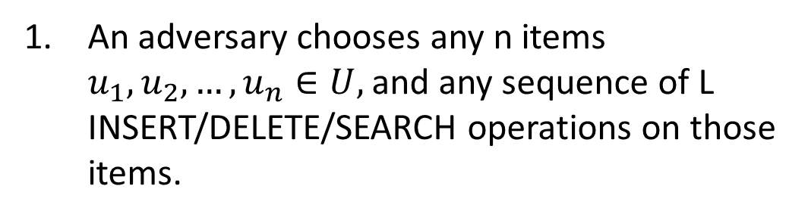
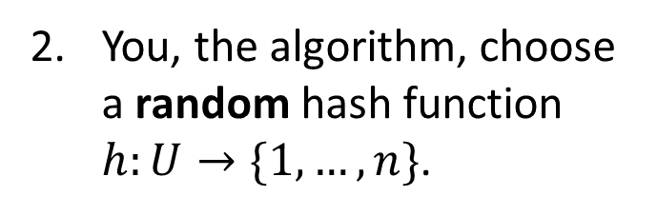
We studied this game
An adversary chooses any n items $u_{1},u_{2},…, u_{n}∈U,$and any sequence of L INSERT/DELETE/SEARCH operations on those items.
You, the algorithm, choose a random hash function $h:U→\{1,…,n\}$.
13
22
43
92
7
HASH IT OUT
1
43
INSERT 13, INSERT 22, INSERT 43, INSERT 92, INSERT 7, SEARCH 43, DELETE 92, SEARCH 7, INSERT 92
2
22
3
13
u_{j}
u_{k}
…
u_{i}
n
92
7

Slide 63
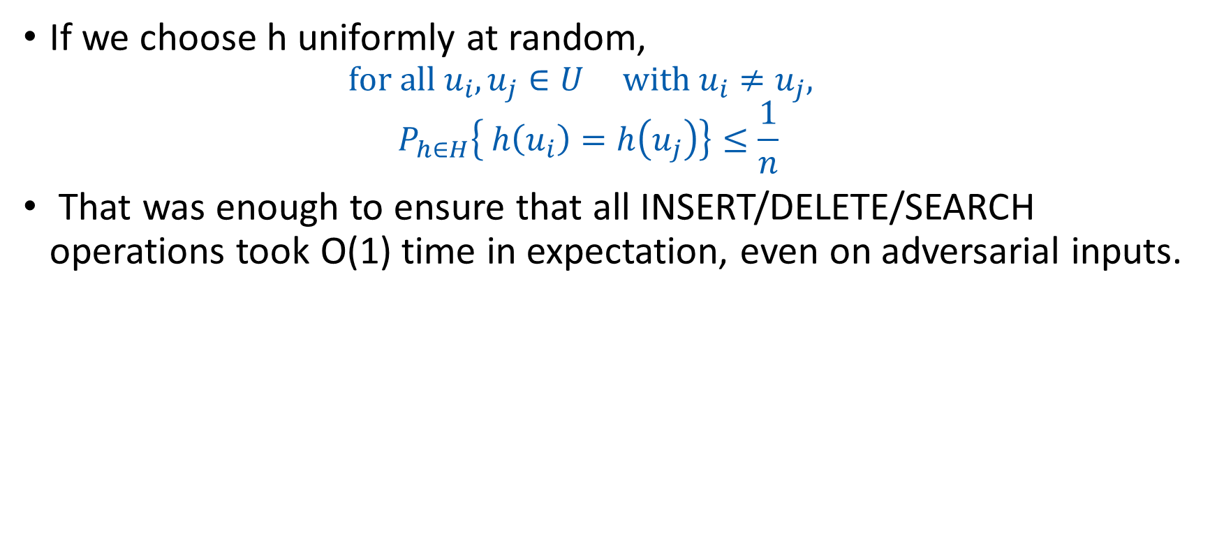
Uniformly random h was good
If we choose h uniformly at random,
$$for all u_{i}, u_{j}∈U with u_{i}≠u_{j},$$
$$P_{h∈H}\left\{ h\left(u_{i}\right)=h\left(u_{j}\right)\right\}≤\frac{1}{n}$$
That was enough to ensure that all INSERT/DELETE/SEARCH operations took O(1) time in expectation, even on adversarial inputs.

Slide 64
Uniformly random h was bad
If we actually want to implement this, we have to store the hash function h.
That takes a lot of space!
We may as well have just initialized a bucket for every single item in U.
All of the hash functions h:U →{1,…,n}
Instead, we chose a function randomly from a smaller set.

Slide 65
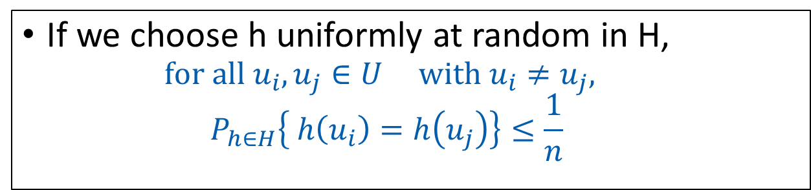
Universal Hash Families
H is a universal hash family if:
If we choose h uniformly at random in H,
$$for all u_{i}, u_{j}∈U with u_{i}≠u_{j},$$
$$P_{h∈H}\left\{ h\left(u_{i}\right)=h\left(u_{j}\right)\right\}≤\frac{1}{n}$$
This was all we needed to make sure that the buckets were balanced in expectation!
We gave an example of a really small universal hash family, of size O(M²)
That means we need only O(log M) bits to store it.

Slide 66
Conclusion:
Hashing a universe of size M into n buckets, where at most n of the items in M ever show up.
We can build a hash table that supports INSERT/DELETE/SEARCH in O(1) expected time
Requires O(n log(M)) bits of space.
O(n) buckets
O(n) items with log(M) bits per item
O(log(M)) to store the hash function

Slide 67
Sorting lower bounds and O(n)-time sorting

Slide 68
Roadmap
More detailed schedule on the website!
Randomized Algs
Asymptotic Analysis
Data structures
Sorting
Divide and conquer
Recurrences
MIDTERM
Dynamic Programming
Greedy Algs
Graphs!
Longest, Shortest, Max and Min…
FINAL
The
Future!

Slide 69
Sorting
We’ve seen a few O(n log(n))-time algorithms.
MERGESORT has worst-case running time O(n log(n))
QUICKSORT has expected running time O(n log(n))
Can we do better?
Depends on who you ask…

Slide 70
An O(1)-time algorithm for sorting:
StickSort
Problem: sort these n sticks by length.
Now they are sorted this way.
Algorithm:
Drop them on a table.

Slide 71
That may have been unsatisfying
But StickSort does raise some important questions:
What is our model of computation?
Input: array
Output: sorted array
Operations allowed: comparisons
-vs-
Input: sticks
Output: sorted sticks in vertical order
Operations allowed: dropping on tables
What are reasonable models of computation?

Slide 72
Today: two models
Comparison-based sorting model
This includes MergeSort, QuickSort, InsertionSort
We’ll see that any algorithm in this model must take at least Ω(n log(n)) steps.
Another model (more reasonable than the stick model…)
CountingSort and RadixSort
Both run in time O(n)

Slide 73
Comparison-based sorting

Slide 74
Comparison-based sorting algorithms
You want to sort an array of items.
You can’t access the items’ values directly: you can only compare two items and find out which is bigger or smaller.

Slide 75
Comparison-based sorting algorithms
is shorthand for
“the first thing in the input list”
Want to sort these items.
There’s some ordering on them, but we don’t know what it is.
Is bigger than ?
YES
There is a genie who knows what the right order is.
The genie can answer YES/NO questions of the form:
is [this] bigger than [that]?
The algorithm’s job is to output a correctly sorted list of all the objects.
Algorithm

Slide 76
All the sorting algorithms we have seen work like this.
Pivot!
eg, QuickSort:
7
6
3
7
6
3
5
1
4
2
7
5
YES
Is bigger than ?
6
5
YES
Is bigger than ?
3
5
NO
Is bigger than ?
5
etc.

Slide 77
Lower bound of Ω(n log(n)).
Theorem:
Any deterministic comparison-based sorting algorithm must take Ω(n log(n)) steps.
Any randomized comparison-based sorting algorithm must take Ω(n log(n)) steps in expectation.
How might we prove this?
Consider all comparison-based algorithms, one-by-one, and analyze them.
Don’t do that.
This covers all the sorting algorithms we know!!!
Instead, argue that all comparison-based sorting algorithms give rise to a decision tree.
Then analyze decision trees.

Slide 78
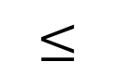
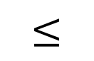
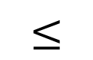
Decision trees
Sort these three things.
$$≤$$
?
YES
NO
$$≤$$
?
etc…
YES
NO
$$≤$$
?
YES
NO

Slide 79
Decision trees
Internal nodes correspond to yes/no questions.
Each internal node has two children, one for “yes” and one for “no.”
Leaf nodes correspond to outputs.
In this case, all possible orderings of the items.
Running an algorithm on a particular input corresponds to a particular path through the tree.
?
YES
NO
?
?
YES
NO
YES
NO
?
?
?
?

Slide 80
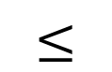
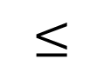
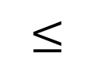
Comparison-based algorithms look like decision trees.
Pivot!
$$≤$$
?
YES
NO
Example: Sort these three things using QuickSort.
L
R
L
R
$$≤$$
?
etc...
YES
NO
Pivot!
L
R
L
R
Now recurse on R
Return
$$≤$$
?
Then we’re done (after some base-case stuff)
YES
NO
L
R
L
R
In either case, we’re done (after some base case stuff and returning recursive calls).
Return
Return

Slide 81
Q: What’s the runtime on a particular input?
A: At least the length of the path from the root to the corresponding leaf.
If we take this path through the tree, the runtime is
Ω(length of the path).
?
YES
NO
?
?
YES
NO
YES
NO
?
?
?
?

Slide 82
Q: What’s the worst-case runtime?
A: At least Ω(length of the longest path).
?
YES
NO
?
?
YES
NO
YES
NO
?
?
?
?

Slide 83
How long is the longest path?
being sloppy about floors and ceilings!
We want a statement: in all such trees, the longest path is at least _____
?
This is a binary tree with at least _____ leaves.
The shallowest tree with n! leaves is the completely balanced one, which has depth ______.
So in all such trees, the longest path is at least log(n!).
YES
NO
n!
?
?
YES
NO
YES
NO
?
?
?
?
log(n!)
n! is about (n/e)^{n} (Stirling’s approx.*).
log(n!) is about n log(n/e) = Ω(n log(n)).
Conclusion: the longest path has length at least Ω(n log(n)).
*Stirling’s approximation is a bit more complicated than this, but this is good enough for the asymptotic result we want.

Slide 84
Lower bound of Ω(n log(n)).
Theorem:
Any deterministic comparison-based sorting algorithm must take Ω(n log(n)) steps.
Proof recap:
Any deterministic comparison-based algorithm can be represented as a decision tree with n! leaves.
The worst-case running time is at least the depth of the decision tree.
All decision trees with n! leaves have depth Ω(n log(n)).
So any comparison-based sorting algorithm must have worst-case running time at least Ω(n log(n)).

Slide 85
\end{Aside}
Aside: What about randomized algorithms?
For example, QuickSort?
Theorem:
Any randomized comparison-based sorting algorithm must take Ω(n log(n)) steps in expectation.
Proof:
(same ideas as deterministic case)
(you are not responsible for this proof in this class)
Try to prove this yourself!
Ollie the over-achieving ostrich

Slide 86
So that’s bad news
Theorem:
Any deterministic comparison-based sorting algorithm must take Ω(n log(n)) steps.
Theorem:
Any randomized comparison-based sorting algorithm must take Ω(n log(n)) steps in expectation.

Slide 87
On the bright side, MergeSort is optimal!
This is one of the cool things about lower bounds like this: we know when we can declare victory!

Slide 88
But what about StickSort?
StickSort can’t be implemented as a comparison-based sorting algorithm. So these lower bounds don’t apply.
But StickSort was kind of silly.
Especially if I have to spend time cutting all those sticks to be the right size!
Can we do better?
Is there another model of computation that’s less silly than the StickSort model, in which we can sort faster than nlog(n)?

Slide 89
Beyond comparison-based sorting algorithms

Slide 90
Another model of computation
The items you are sorting have meaningful values.
9
6
3
5
2
1
2
instead of

Slide 91
Pre-lecture exercise
How long does it take to sort n people by their month of birth?
Share your answers
1 (Jan)
1 (Jan)
4 (Apr)
5 (May)

Slide 92
Another model of computation
The items you are sorting have meaningful values.
9
6
3
5
2
1
2
instead of

Slide 93
Why might this help?
9
6
3
5
2
1
2
Implement the buckets as linked lists. They are first-in, first-out. This will be useful later.
CountingSort:
2
1
2
3
5
6
9
1
2
3
4
5
6
7
8
9
Concatenate the buckets!
SORTED!
In time O(n).

Slide 94
Assumptions
Need to be able to know what bucket to put something in.
We assume we can evaluate the items directly, not just by comparison
Need to know what values might show up ahead of time.
Need to assume there are not too many such values.
2
12345
13
2¹⁰⁰⁰
50
100000000
1

Slide 95
RadixSort
For sorting integers up to size M
or more generally for lexicographically sorting strings
Can use less space than CountingSort
Idea: CountingSort on the least-significant digit first, then the next least-significant, and so on.

Slide 96
Step 1: CountingSort on least significant digit
21
345
13
101
50
234
1
1
101
234
345
50
13
21
0
1
2
3
4
5
6
7
8
9
50
21
101
1
13
234
345

Slide 97
Step 2: CountingSort on the 2nd least sig. digit
50
21
101
1
13
234
345
1
345
13
21
234
50
101
0
1
2
3
4
5
6
7
8
9
101
1
13
21
234
345
50

Slide 98
Step 3: CountingSort on the 3rd least sig. digit
101
1
13
21
234
345
50
50
21
13
234
345
1
101
0
1
2
3
4
5
6
7
8
9
1
13
21
50
101
234
345
It worked!!

Slide 99
Why does this work?
Original array:
21
345
13
101
50
234
1
Next array is sorted by the first digit.
50
21
101
1
13
234
345
50
21
101
1
13
234
345
Next array is sorted by the first two digits.
101
1
13
21
234
345
50
101
01
13
21
234
345
50
Next array is sorted by all three digits.
1
13
21
50
101
234
345
001
013
021
050
101
234
345
Sorted array

Slide 100
To prove this is correct…
What is the inductive hypothesis?
Original array:
21
345
13
101
50
234
1
Next array is sorted by the first digit.
50
21
101
1
13
234
345
50
21
101
1
13
234
345
Next array is sorted by the first two digits.
101
1
13
21
234
345
50
Think-Share Terrapins
101
01
13
21
234
345
50
Next array is sorted by all three digits.
1
13
21
50
101
234
345
001
013
021
050
101
234
345
Sorted array

Slide 101
RadixSort is correct
Inductive hypothesis:
After the k’th iteration, the array is sorted by the first k least-significant digits.
Base case:
“Sorted by 0 least-significant digits” means not yet sorted, so the IH holds for k=0.
Inductive step:
TO DO
Conclusion:
The inductive hypothesis holds for all k, so after the last iteration, the array is sorted by all the digits. Hence, it’s sorted!

Slide 102
Inductive step
Inductive hypothesis:
After the k’th iteration, the array is sorted by the first k least-significant digits.
Need to show: if IH holds for k=i-1, then it holds for k=i.
Suppose that after the i-1’st iteration, the array is sorted by the first i-1 least-significant digits.
Need to show that after the i’th iteration, the array is sorted by the first i least-significant digits.
IH: this array is sorted by first digit.
050
021
101
002
013
234
345
002
EXAMPLE: i=2
234
345
101
013
021
050
0
1
2
3
4
5
6
7
8
9
101
002
013
021
234
345
050
Want to show: this array is sorted by 1st and 2nd digits.

Slide 103
Proof sketch…proof on next (skipped) slide
Want to show: after the i’th iteration, the array is sorted by the first i least-significant digits.
Let x=[x_{d}x_{d-1}…x₂x₁] and y=[y_{d}y_{d-1}…y₂y₁] be any x,y.
Suppose [x_{i}x_{i-1}…x₂x₁] < [y_{i}y_{i-1}…y₂y₁].
Want to show that x appears before y at end of i’th iteration.
CASE 1: x_{i}<y_{i}
x is in an earlier bucket than y.
Aka, we want to show that for any x and y so that x belongs before y, we put x before y.
IH: this array is sorted by first digit.
x
y
050
021
101
002
013
234
345
002
x
y
EXAMPLE: i=2
234
345
101
013
021
050
0
1
2
3
4
5
6
7
8
9
x
y
101
002
013
021
234
345
050
Want to show: this array is sorted by 1st and 2nd digits.

Slide 104
Proof sketch…proof on next (skipped) slide
Let x=[x_{d}x_{d-1}…x₂x₁] and y=[y_{d}y_{d-1}…y₂y₁] be any x,y.
Suppose [x_{i}x_{i-1}…x₂x₁] < [y_{i}y_{i-1}…y₂y₁].
Want to show that x appears before y at end of i’th iteration.
CASE 1: x_{i}<y_{i}
x is in an earlier bucket than y.
CASE 2: x_{i}=y_{i}
[x_{i-1}…x₂x₁] < [y_{i-1}…y₂y₁],
x and y in same bucket, but x was put in the bucket first.
Want to show: after the i’th iteration, the array is sorted by the first i least-significant digits.
Aka, we want to show that for any x and y so that x belongs before y, we put x before y.
IH: this array is sorted by first digit.
y
050
021
x
101
002
013
234
345
y
002
EXAMPLE: i=2
234
345
101
x
013
021
050
0
1
2
3
4
5
6
7
8
9
x
y
101
002
013
021
234
345
050
Want to show: this array is sorted by 1st and 2nd digits.

Slide 105
After the i’th iteration, sorted by the first i least-significant digits
Let x=[x_{d}x_{d-1}…x₂x₁] and y=[y_{d}y_{d-1}…y₂y₁] be any x,y.
Suppose [x_{i}x_{i-1}…x₂x₁] < [y_{i}y_{i-1}…y₂y₁].
Want to show that x appears before y at end of i’th iteration.
CASE 1: x_{i}<y_{i}.
x appears in an earlier bucket than y, so x appears before y after the i’th iteration.
CASE 2: x_{i}=y_{i}.
x and y end up in the same bucket.
In this case, [x_{i-1}…x₂x₁] < [y_{i-1}…y₂y₁], so by the inductive hypothesis, x appeared before y after i-1’st iteration.
Then x was placed into the bucket before y was, so it also comes out of the bucket before y does.
Recall that the buckets are FIFO queues.
So x appears before y in the i’th iteration.
SLIDE SKIPPED IN CLASS. Here for reference.

Slide 106
Inductive step
Inductive hypothesis:
After the k’th iteration, the array is sorted by the first k least-significant digits.
Need to show: if IH holds for k=i-1, then it holds for k=i.
Suppose that after the i-1’st iteration, the array is sorted by the first i-1 least-significant digits.
Need to show that after the i’th iteration, the array is sorted by the first i least-significant digits.
IH: this array is sorted by first digit.
050
021
101
002
013
234
345
002
EXAMPLE: i=2
234
345
101
013
021
050
0
1
2
3
4
5
6
7
8
9
101
002
013
021
234
345
050
Want to show: this array is sorted by 1st and 2nd digits.

Slide 107
RadixSort is correct
Inductive hypothesis:
After the k’th iteration, the array is sorted by the first k least-significant digits.
Base case:
“Sorted by 0 least-significant digits” means not sorted, so the IH holds for k=0.
Inductive step:
TO DO
Conclusion:
The inductive hypothesis holds for all k, so after the last iteration, the array is sorted by all the digits. Hence, it’s sorted!

Slide 108
What is the running time?
for RadixSorting numbers base-10.
Suppose we are sorting n d-digit numbers (in base 10).
How many iterations are there?
How long does each iteration take?
What is the total running time?
e.g., n=7, d=3:
021
345
013
101
050
234
001
Think-Share Terrapins

Slide 109
What is the running time?
for RadixSorting numbers base-10.
Suppose we are sorting n d-digit numbers (in base 10).
How many iterations are there?
d iterations
How long does each iteration take?
Time to initialize 10 buckets, plus time to put n numbers in 10 buckets. O(n).
What is the total running time?
O(nd)
e.g., n=7, d=3:
021
345
013
101
050
234
001
Think-Share Terrapins

Slide 110
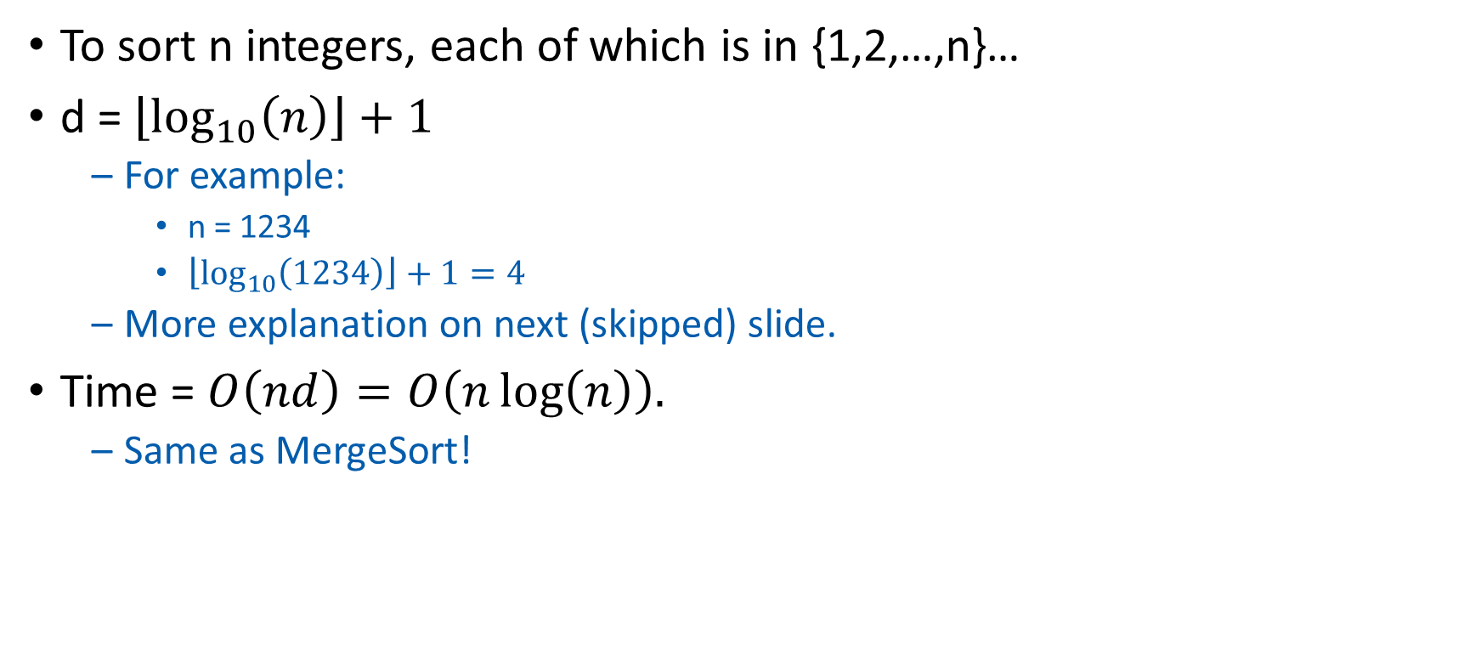
This doesn’t seem so great
To sort n integers, each of which is in {1,2,…,n}…
d = $\left\lfloor \log_{10}\left(n\right)\right\rfloor +1$
For example:
n = 1234
$\left\lfloor \log_{10}\left(1234\right)\right\rfloor +1=4$
More explanation on next (skipped) slide.
Time = $O\left(nd\right)=O\left(n\log\left(n\right)\right).$
Same as MergeSort!

Slide 111
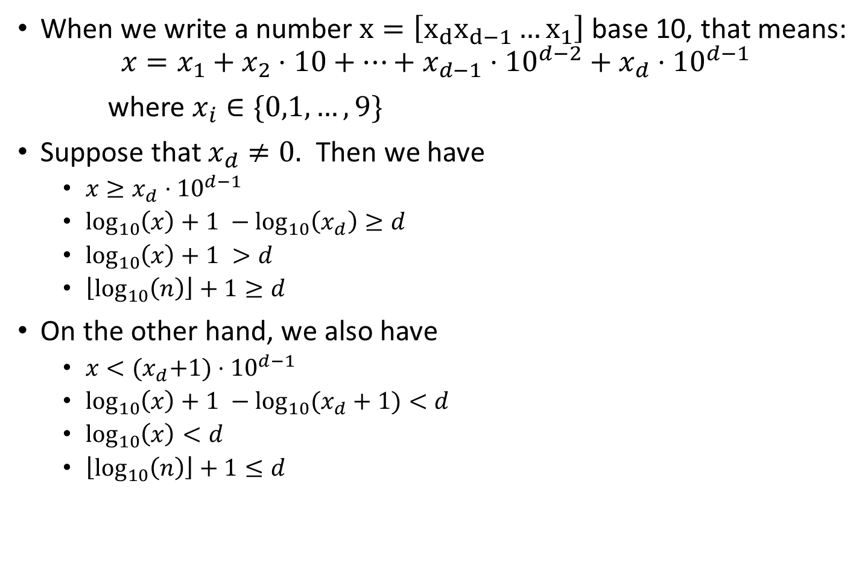
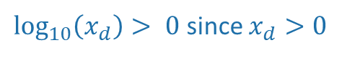
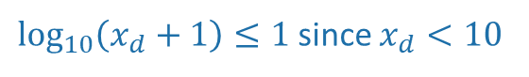
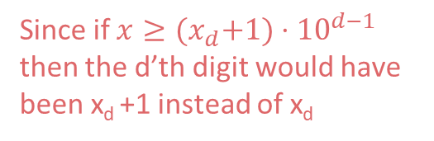
Aside: why $d=\left\lfloor \log_{10}\left(n\right)\right\rfloor +1$ ?
When we write a number $x=\left[x_{d}x_{d−1}…x_{1}\right]$ base 10, that means:
$$x=x_{1}+x_{2}⋅10+⋯+x_{d−1}⋅{10}^{d−2}+x_{d}⋅{10}^{d−1}$$
where $x_{i}∈\{0,1,…,9\}$
Suppose that $x_{d}≠0.$ Then we have
$x≥x_{d}⋅{10}^{d−1}$
$\log_{10}\left(x\right)+1 −\log_{10}\left(x_{d}\right)≥d$
$\log_{10}\left(x\right)+1 >d$
$\left\lfloor \log_{10}\left(n\right)\right\rfloor +1≥d$
On the other hand, we also have
$x<{(x}_{d}+1)⋅{10}^{d−1}$
$\log_{10}\left(x\right)+1 −\log_{10}{(x_{d}+1)}<d$
$\log_{10}\left(x\right)<d$
$\left\lfloor \log_{10}\left(n\right)\right\rfloor +1≤d$
Slide skipped in class
Since x is bigger than just the last term in that sum!
(take logs of both sides and rearrange)
$\log_{10}\left(x_{d}\right)> 0$since $x_{d}>0$
Since d is an integer
Since if $x≥{(x}_{d}+1)⋅{10}^{d−1}$ then the d’th digit would have been x_{d} +1 instead of x_{d}
(take logs of both sides and rearrange)
$\log_{10}\left(x_{d}+1\right)≤1$since $x_{d}<10$
Since d is an integer

Slide 112
Can we do better?
RadixSort base 10 doesn’t seem to be such a good idea…
But what if we change the base? (Let’s say base r)
We will see there’s a trade-off:
Bigger r means more buckets
Bigger r means fewer digits

Slide 113
Example: base 100
Original array:
21
345
13
101
50
234
1

Slide 114
Example: base 100
Original array:
0021
0345
0013
0101
0050
0234
0001
100 buckets:
…
…
…
0001
0101
0234
0050
00
01
02
34
50
98
99
0101
0001
0013
0021
0234
0345
0050

Slide 115
Example: base 100
0101
0001
0013
0021
0234
0345
0050
100 buckets:
0050
0021
…
…
0013
0001
0101
0234
0345
00
01
02
03
50
98
99
0001
0013
0021
0050
0101
0234
0345
Sorted!

Slide 116
Example: base 100
Original array
0021
0345
0013
0101
0050
0234
0001
0101
0001
0013
0021
0234
0345
0050
0001
0013
0021
0050
0101
0234
0345
Sorted array
Base 100:
d=2, so only 2 iterations.
100 buckets
Base 10:
d=3, so 3 iterations.
10 buckets
vs.
Bigger base means more buckets but fewer iterations.

Slide 117

General running time of RadixSort
Say we want to sort:
n integers,
maximum size M,
in base r.
Number of iterations of RadixSort:
Same as number of digits, base r, of an integer x of max size M$.$
That is $d=\left\lfloor \log_{r}\left(M\right)\right\rfloor +1$
Time per iteration:
Initialize r buckets, put n items into them
$O(n+r)$ total time.
Total time:
$O\left(d⋅\left(n+r\right)\right)= O\left(\left( \left\lfloor \log_{r}\left(M\right)\right\rfloor +1 \right)⋅\left(n+r\right)\right)$
Convince yourself that this is the right formula for d.

Slide 118

Trade-offs
Running time: $O\left(\left( \left\lfloor \log_{r}\left(M\right)\right\rfloor +1 \right)⋅\left(n+r\right)\right)$
Given n, M, how should we choose r?
Looks like there’s some sweet spot:
IPython Notebook

Slide 119

A reasonable choice: r=n
Running time:
$$O\left(\left( \left\lfloor \log_{r}\left(M\right)\right\rfloor +1 \right)⋅\left(n+r\right)\right)$$
Choose n=r:
$$O\left(n⋅\left( \left\lfloor \log_{n}\left(M\right)\right\rfloor +1 \right)\right)$$
Intuition: balance n and r here.
Choosing r = n is pretty good. What choice of r optimizes the asymptotic running time? What if I also care about space?
Ollie the over-achieving ostrich

Slide 120

Running time of RadixSort with r=n
To sort n integers of size at most M, time is
$O\left(n⋅\left( \left\lfloor \log_{n}\left(M\right)\right\rfloor +1 \right)\right)$
So the running time (in terms of n) depends on how big M is in terms of n:
If $M≤n^{c}$ for some constant c, then this is O(n).
If $M=2^{n}$, then this is $O\left(\frac{n^{2}}{log⁡(n)}\right)$
The number of buckets needed is r=n.

Slide 121
What have we learned?
You can put any constant here instead of 100.
RadixSort can sort n integers of size at most n¹⁰⁰ in time O(n), and needs enough space to store O(n) integers.
If your integers have size much much bigger than n (like 2^{n}), maybe you shouldn’t use RadixSort.
It matters how we pick the base.

Slide 122
Recap
How difficult sorting is depends on the model of computation.
How reasonable a model of computation is is up for debate.
Comparison-based sorting model
This includes MergeSort, QuickSort, InsertionSort
Any algorithm in this model must use at least Ω(n log(n)) operations. ☹
But it can handle arbitrary comparable objects. ☺
If we are sorting small integers (or other reasonable data):
CountingSort and RadixSort
Both run in time O(n) ☺
Might take more space and/or be slower if integers get too big ☹

Slide 123
The End

